Slide 1
User Profile Template
Click to start presentation

Slide 2
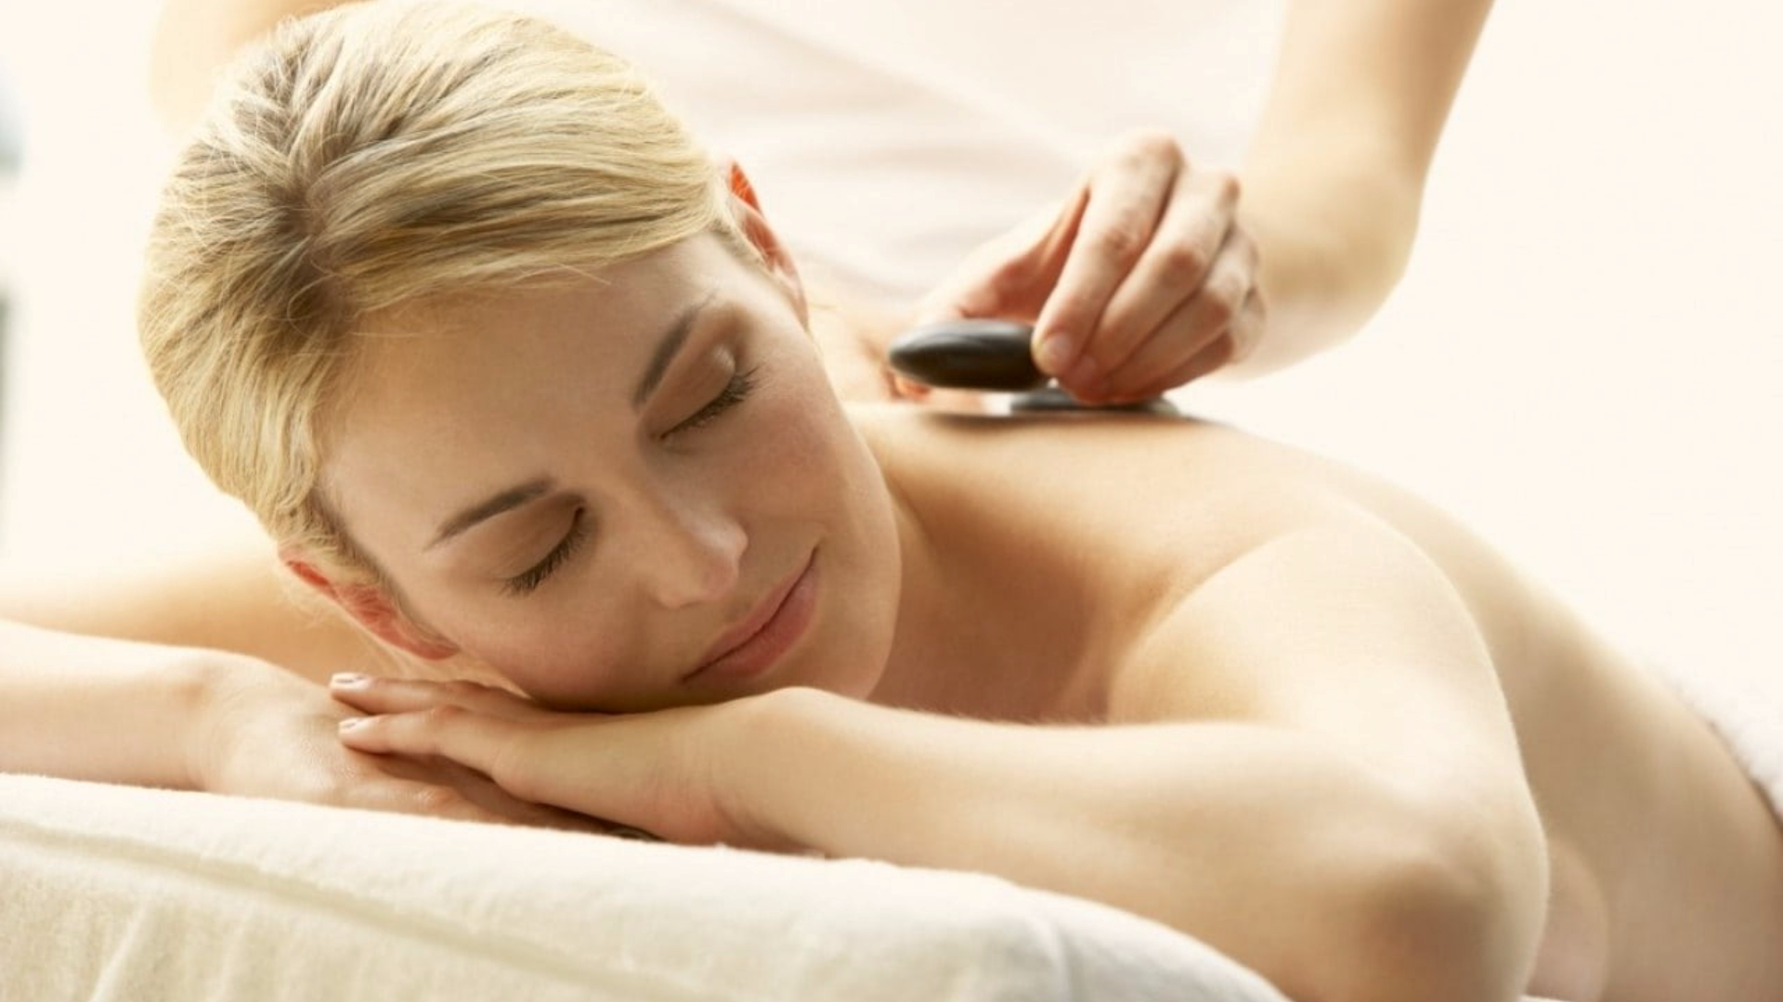

Home
Therapists
Book now
About us
Contacts
Profile
Sign out
Germany Mobile Spa
Relax. Rejuvenate. Renew.
Discover the healing power of touch. Our expert massage therapies not only melt away stress but also improve circulation, relieve muscle tension, and promote overall well-being. Invest in your health —because you deserve it.
Find your closest therapist

Slide 3
Home
Therapists
Book now
About us
Contacts
Profile
Sign out
Germany Mobile Spa
Relax. Rejuvenate. Renew.
Discover the healing power of touch. Our expert massage therapies not only melt away stress but also improve circulation, relieve muscle tension, and promote overall well-being. Invest in your health —because you deserve it.
Find your closest therapist

Slide 4
Home
Therapists
Book now
About us
Contacts
Profile
Sign out
Germany Mobile Spa
Relax. Rejuvenate. Renew.
Discover the healing power of touch. Our expert massage therapies not only melt away stress but also improve circulation, relieve muscle tension, and promote overall well-being. Invest in your health —because you deserve it.
Find your closest therapist

Slide 5
Home
Therapists
Book now
About us
Contacts
Profile
Sign out
Germany Mobile Spa

Slide 6



Home
Therapists
Book now
About us
Contacts
Profile
Sign out
Germany Mobile Spa
Personal Details
Profile picture
First name*
Last name*
Sex*
Age*
Preferences
Stephany
Anniston
Female
25
Settings
Full address*
Billing
Kitaibelite 30, Berlin 10034
Upload new
Email address*
Delete
XXXXXXXXXXXX@gmail.com
+49 XXX XXX XXXX
Password*
Confirm Password*
Change Password
***************
***************
Save Password
Forgotten Password
Security Question
Remove
***************
Security Answer
Remove
***************
Save Changes
Discard Changes

Slide 7
Home
Therapists
Book now
About us
Contacts
Profile
Sign out
Germany Mobile Spa
Profile picture
First name*
Last name*
Sex*
Age*
Stephany
Anniston
Female
25
Personal Details
Full address*
Preferences
Kitaibelite 30, Berlin 10034
Upload new
Email address*
Settings
Delete
XXXXXXXXXXXX@gmail.com
+49 XXX XXX XXXX
Billing
Password*
Confirm Password*
Change Password
***************
***************
Save Password
Forgotten Password
Security Question
Remove
***************
Security Answer
Remove
***************
Save Changes
Discard Changes

Slide 8
Home
Therapists
Book now
About us
Contacts
Profile
Sign out
Germany Mobile Spa
Profile picture
First name*
Last name*
Sex*
Age*
Stephany
Anniston
Female
25
Personal Details
Full address*
Preferences
Kitaibelite 30, Berlin 10034
Upload new
Email address*
Settings
Delete
XXXXXXXXXXXX@gmail.com
+49 XXX XXX XXXX
Billing
Password*
Confirm Password*
Change Password
***************
***************
Save Password
Forgotten Password
Security Question
Remove
***************
Security Answer
Remove
***************
Save Changes
Discard Changes

Slide 9
Home
Therapists
Book now
About us
Contacts
Profile
Sign out
Germany Mobile Spa
Profile picture
First name*
Last name*
Sex*
Age*
Personal Details
Preferences
Settings
Billing

Slide 10
Home
Therapists
Book now
About us
Contacts
Profile
Sign out
Germany Mobile Spa
Profile picture
First name*
Last name*
Sex*
Age*
Personal Details
Preferences
Settings
Billing

